Slide 1


Software Solution
We provide software solution for
your every problem.
Team Members
Muhammad Fahad (FA19-BSSE-0014)
Ahmed Amin (FA19-BSSE-0063)
A project of FA Software Solution

Slide 2

Meet our team
Muhammad Fahad
Backend Developer
.NET Developer
Database Manager
Project manager
System Analyst
Requirement Engineer
Ahmed Amin
Frontend Developer
Designer
Quality Assurance
Business Analyst
Financial Adviser
Product Champion

Slide 3
Background
This system is created because many banquet owner & manager are facing the problem of managing schedule, dealing customers & saving their time On the other hand, the customers have to visit each banquet so they can choose which banquet they have to book for their event but by this website they can compare multiple banquets, see their specialty and can also get good recommendation for their events.
Celebrate the celebration in the best way

Slide 4
Vision Statement
For banquet owners Who need an online banquet booking system, the banquet booking is a web app that provide online banquet booking, with their schedule and show unbook slots, it’s a time efficient system. Unlike other booking web apps Our product provides you Comparison of the banquets, nearby banquets and also the banquets according to your budget and event type.
For banquet owners Who need an online banquet booking system, the banquet booking is a web app that provide online banquet booking, with their schedule and show unbook slots, it’s a time efficient system. Unlike other booking web apps Our product provides you Comparison of the banquets, nearby banquets and also the banquets according to your budget and event type.

Slide 5
Business Objectives
Financial
Non-Financial
The booking will increase by 20%.
Banquet owner has to pay 10% on every transaction making it less investment and more revenue.
Increase gross margin from 10% to 30% within 1 year.
Generate revenue of extra 10% due to time efficiency and extra bookings.
The customer will be more satisfied with this software solution.
The options that are provided will attract more customers.
Increase the reliability of the Web App so that more booking can be done here.
Increase the time efficiency of banquets by 20% more.

Slide 6
Business Problems & Objectives
Business Problem 1
Managing record is tough and have to hire a person to manage all the information
Business Problem 2
The booking is time consuming, and owner can’t show the schedule to show the free slots.
Business Problem 3
The customer can’t compare banquet well they have to visit each banquet and it take time and effort.
Business Objective 1
Manage all the record schedule and get all the detail of transactions in banquet’s portal.
Business Objective 2
Increase time efficiency which become reason in more booking increasing revenue by 10%.
Business Objective 3
Comparison increase all the possibility for a customer to make better decision according to their budget.

Slide 7



Business Risk
Acceptance of users
The users will consider it to be much risky for them like online shopping platforms face this issue.
Competition
Even if there is no other web app similar to our or with some new ideas or better feature.
Negative Impact
If a banquet provide bad service it will cause bad impact & every banquet will face loss.

Slide 8
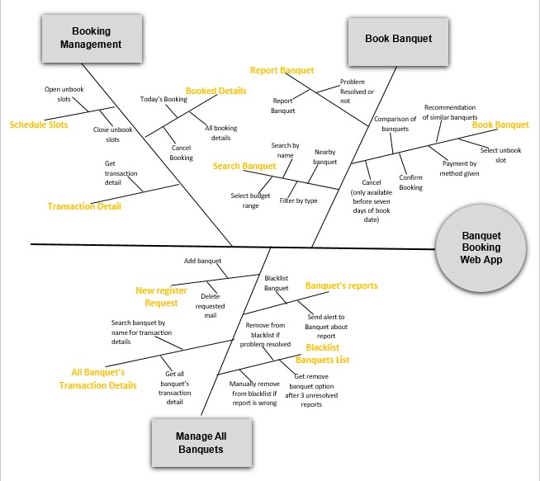
Major Features
The major feature that make our application unique are:
Nearby Banquets: It will show the banquet nearby your location with the help of google map’s API.
Comparison: There is a option for every banquet to compare it with other so you can see the difference of services specialty and budget too.
Recommendation: If a person don’t want to search any banquet by the name, there is a option of filter in the search according to budget, peoples range and specialty, moreover if a person is viewing any banquet our system will recommend more according to same specialty of event.

Slide 9
Version Control
Scope of Initial release
Scope of Subsequent release
The customer will get the feature of nearby banquet.
Customer can compare banquet, select banquet by their speciality & budget.
Banquet’s manager can easily manage schedule & bookings.
Transaction will be done by banking API’s and 10% will be get by web app owner.
Premium membership available for banquets which will give more feature.
Premium members will show top in searching & be more recommended
Discount section will be made to show all the offers available.
Discount section banquet will pay 2% more to web app admin

Slide 10

Limitation and Exclusion
The system will not support the cancellation request before 7 days of the booked date for that the customer has to contact to banquet’s manager by themselves and then it’s on them to cancel your request and refund your amount and the deal will be then between the customers and the banquet manager, Banquet booking web app will not be responsible for your cancellation request to the banquet manager. But when you are booking an alert will be pop up before you confirm booking it will tell you that you can only cancel before 7 days or else you can contact the manager of banquet.

Slide 11

Deployment Consideration
The banquet booking is a web app so there is not limit of the platform it is already a cross platform app. It can work on any web browser as a website but in the 1st release we also release it Mobile web application for both Android and IOS which optimize its performance for the people so that they can easily use that application but at the 2nd release we will optimize it more not like the 1st release. Also in the second release we will also design its Web Application for window platform which will be later available on their Microsoft store.

Slide 12
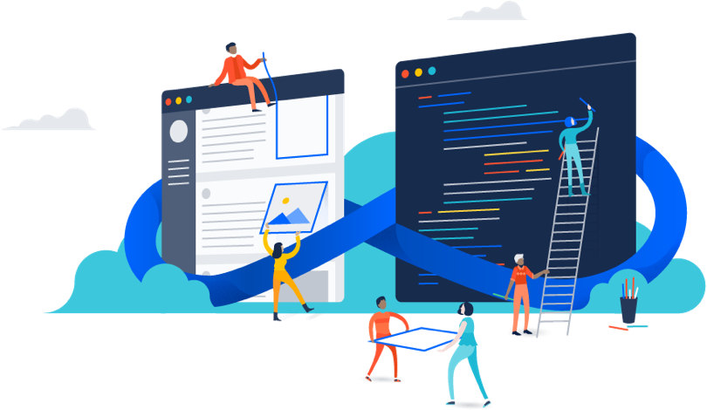
Thank You

